Slide 1


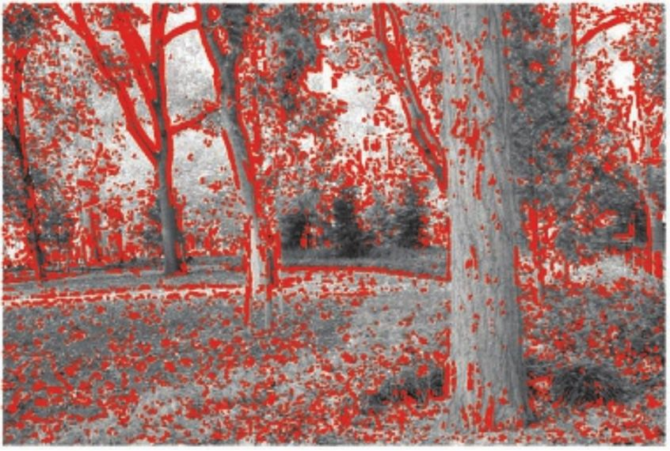
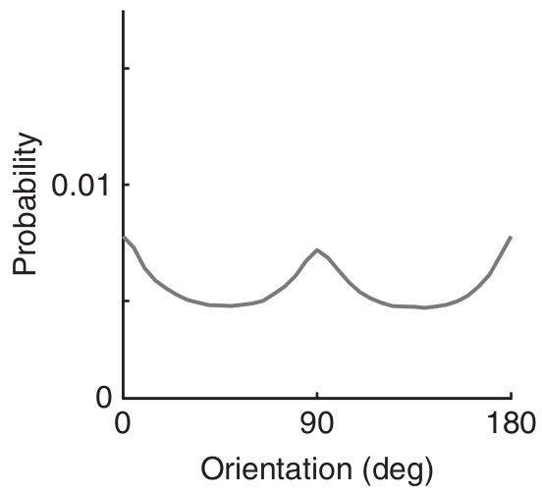
PREDICTION: IMPLEMENTATION MATTERS
Stefan Brugger
Prediction – key element of brain function
Multiple implementations
  Structural constraint
  Top-down expectation
Neglected distinction
Implementation matters for information processing

Slide 2

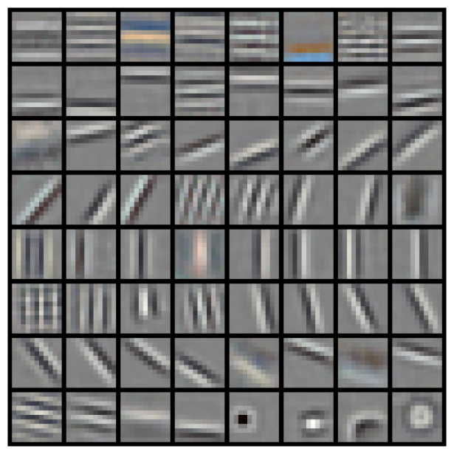

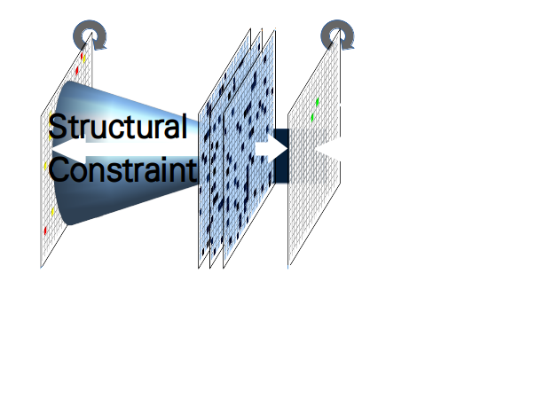
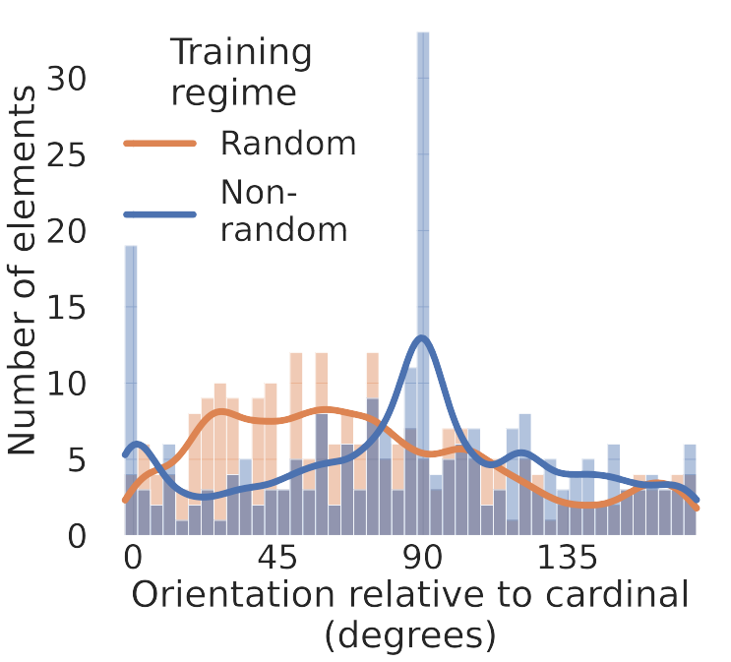
IMPLEMENTATION MATTERS Stefan Brugger
Predictive coding network
Train on natural images
Structural constraint emerges spontaneously
Random vs non-random

Slide 3
IMPLEMENTATION MATTERS Stefan Brugger
Predictive coding network
Train on natural images
Information processing
Representational efficiency
Interaction with top-down expectation
Neurobiological implementation matters

